Slide 1
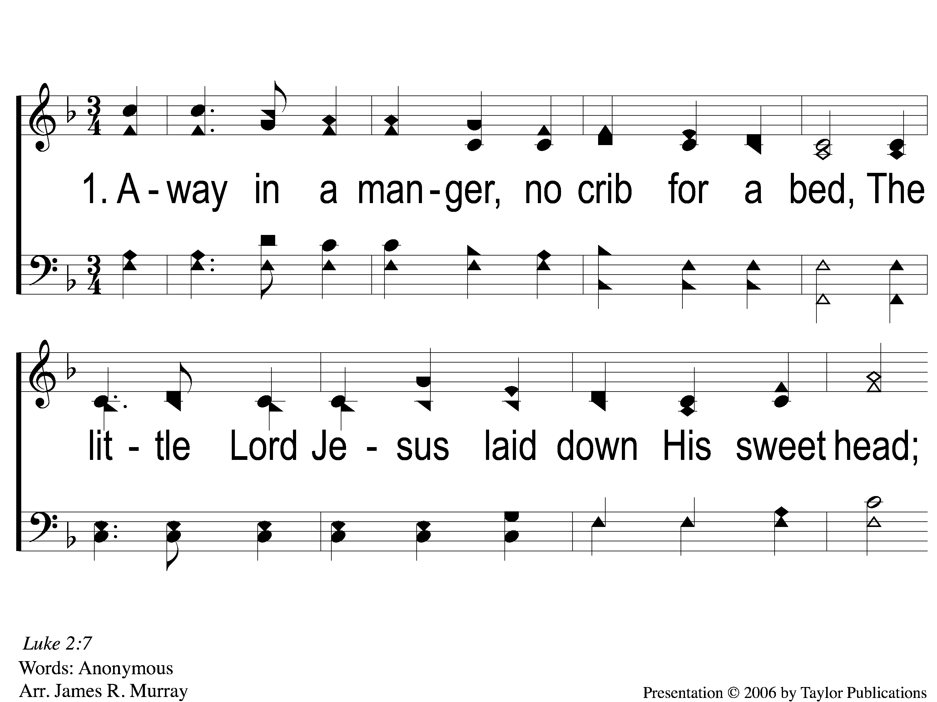
1-1 Away In A Manger
Away In A Manger
1017

Slide 2
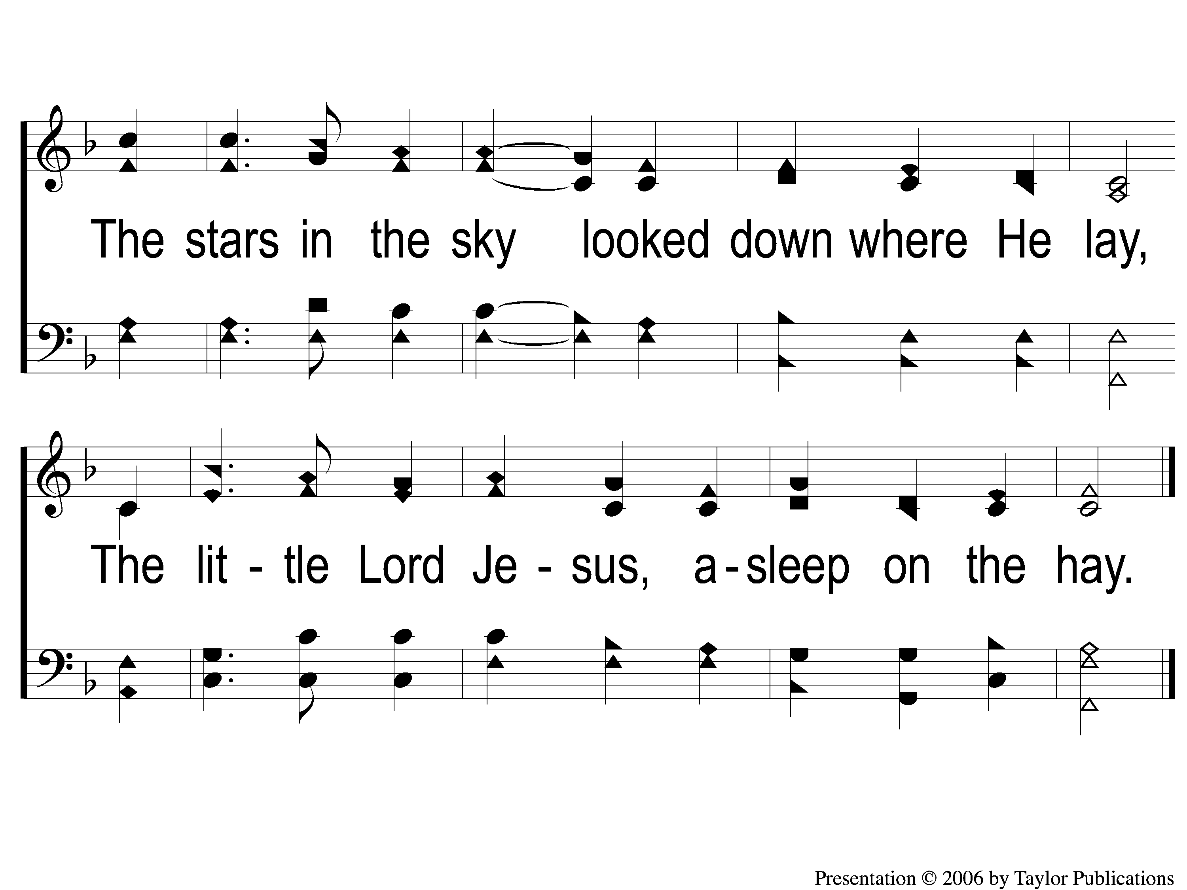
1-2 Away In A Manger
Away In A Manger
1017

Slide 3
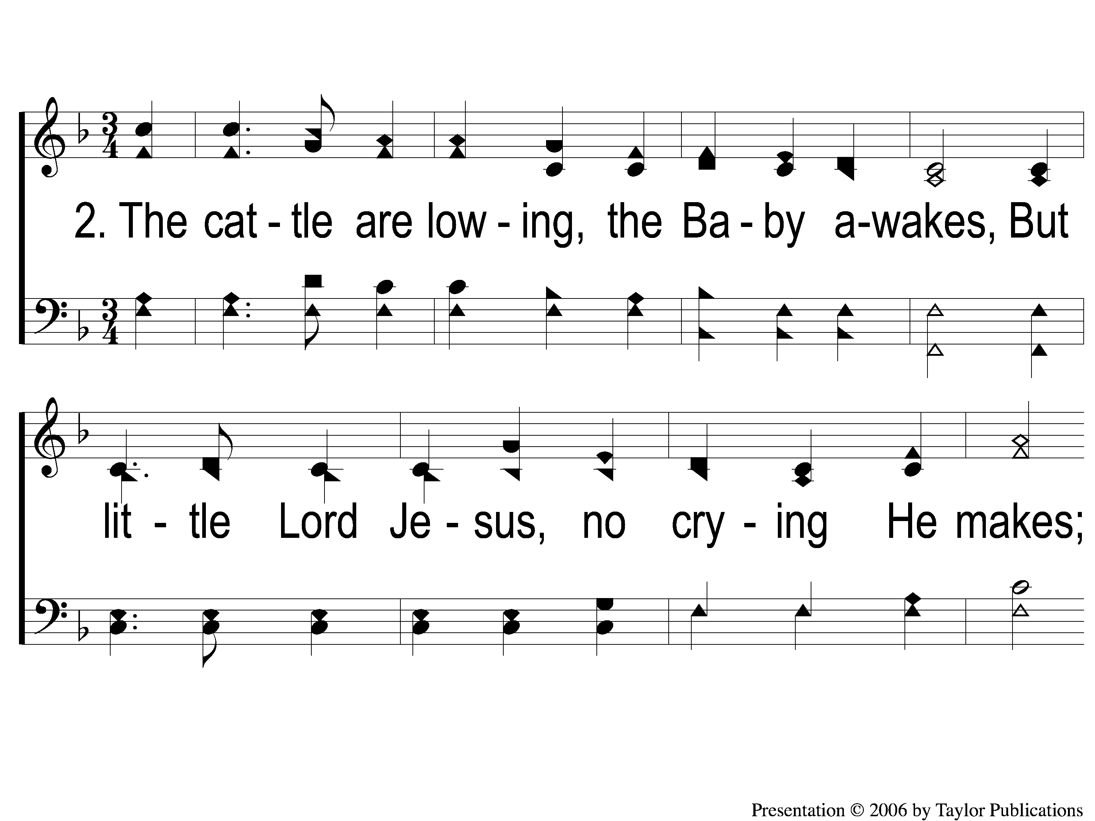
2-1 Away In A Manger
Away In A Manger
1017

Slide 4
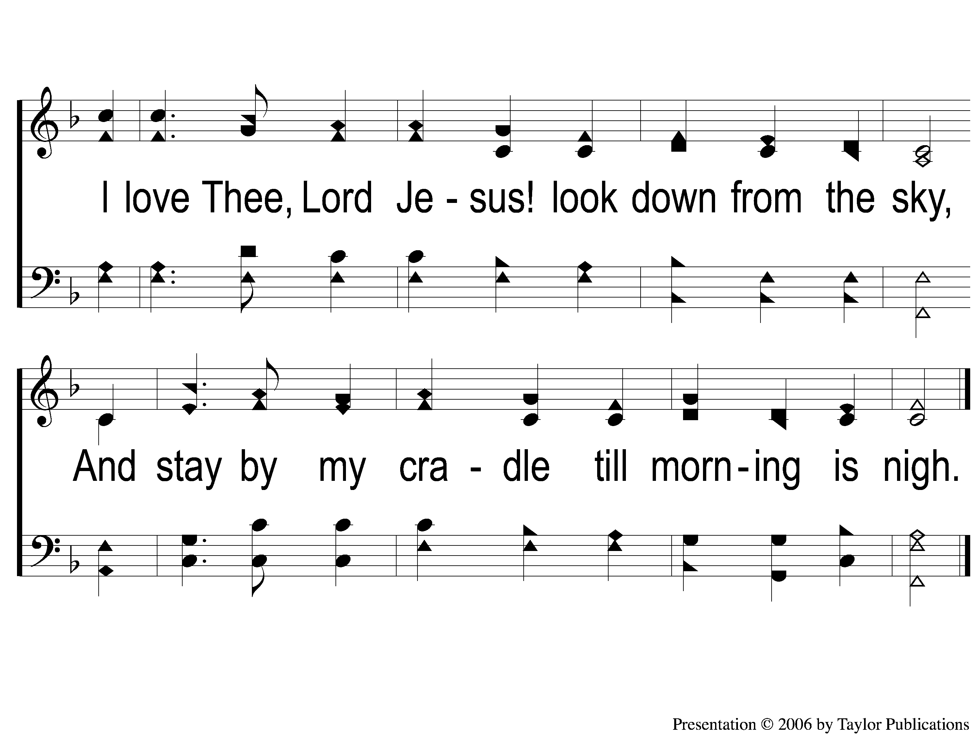
2-2 Away In A Manger
Away In A Manger
1017

Slide 5
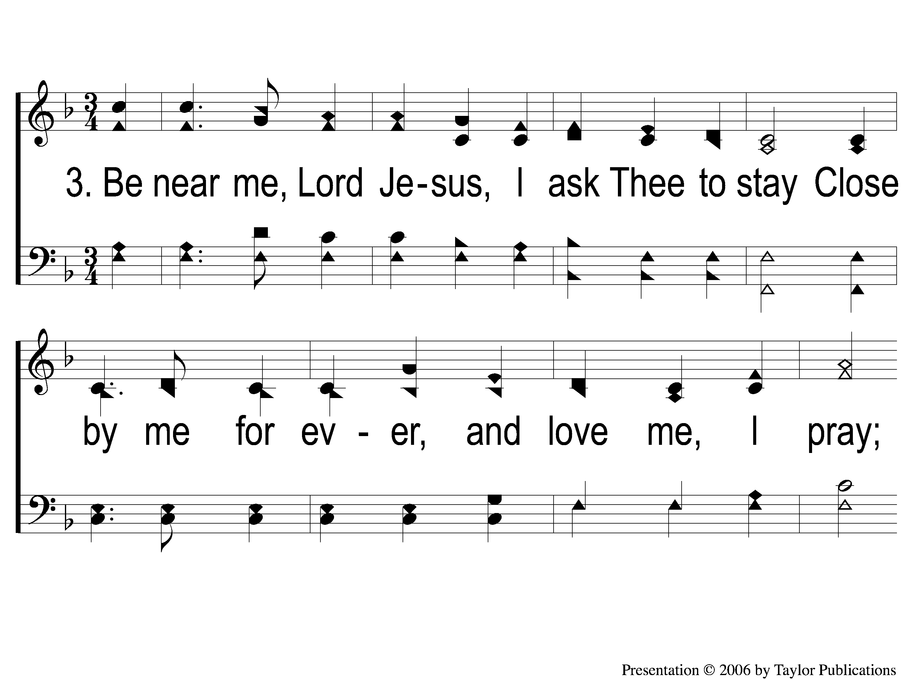
3-1 Away In A Manger
Away In A Manger
1017

Slide 6
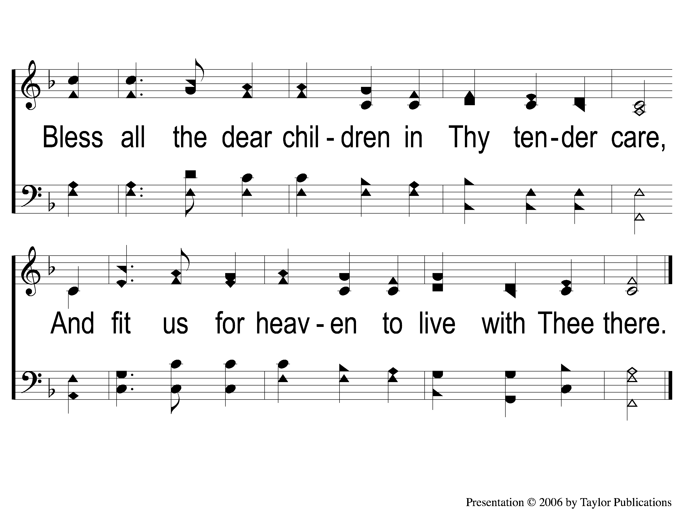
3-2 Away In A Manger
Away In A Manger
1017

